Slide 1
MODIS data for Skagit flood model validation
 | 2006 | 2009
No snow | Oct 21 | Oct 11
Cloud Cover | Oct 22-29 | Nov 4-11
Snow cover | Oct 30 | Nov 12
No snow | Oct 31- Nov 1 | na
Cloud Cover | Nov 2-27 | Nov 13-30
Get observed snow cover area
Of Skagit watershed for:
Oct 21, 2006
Oct 30, 2006
Nov 1, 2006
Oct 11, 2009
Nov 12, 2009

Slide 2
SNOW CONDITIONS in Oct-Nov 2006
MODIS viewer
https://worldview.earthdata.nasa.gov/?p=geographic&l=VIIRS_SNPP_CorrectedReflectance_TrueColor(hidden),MODIS_Aqua_CorrectedReflectance_TrueColor(hidden),MODIS_Terra_CorrectedReflectance_TrueColor,Reference_Labels(hidden),Reference_Features(hidden),Coastlines&t=2006-10-31&z=3&v=-123.1070843755572,47.53692295662773,-120.8087445318072,49.50787022225273&ab=off&as=2006-10-01&ae=2006-10-08&av=3&al=true

Slide 3
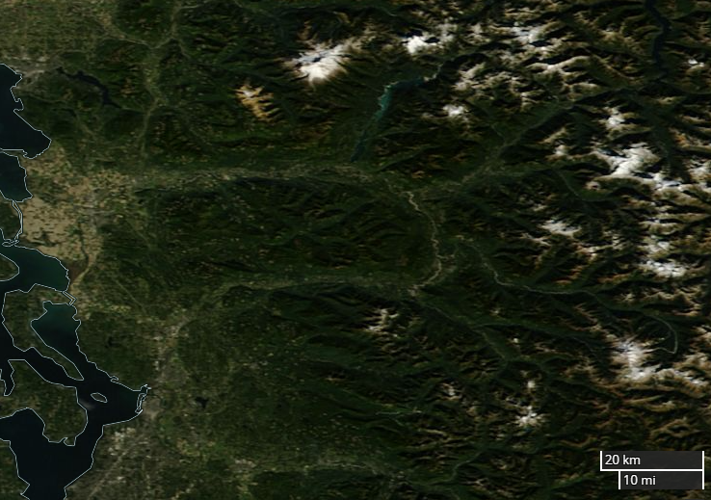
Oct 9-21, 2006

Slide 4
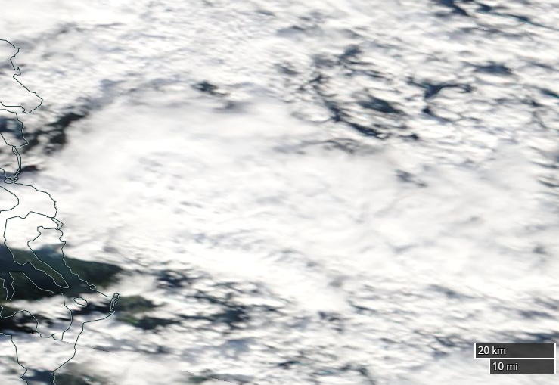
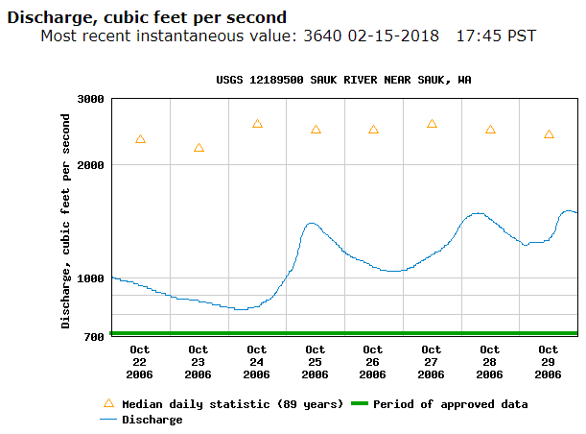
Oct 22-29, 2006

Slide 5
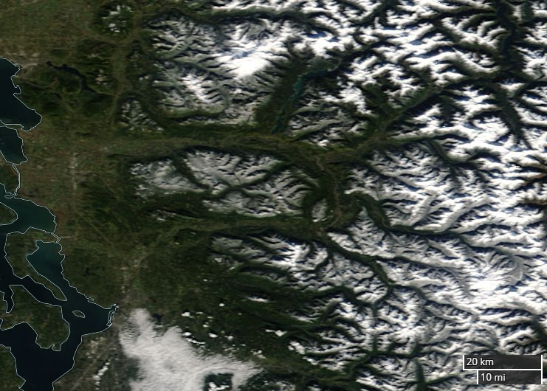
Oct 30, 2006

Slide 6
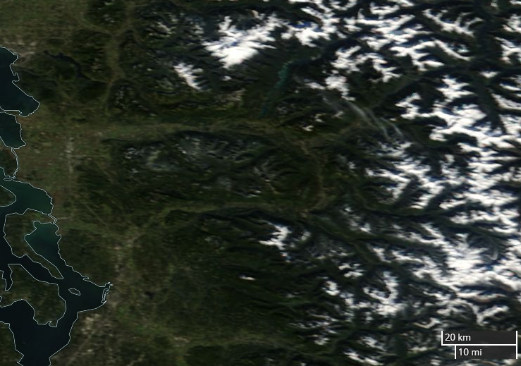
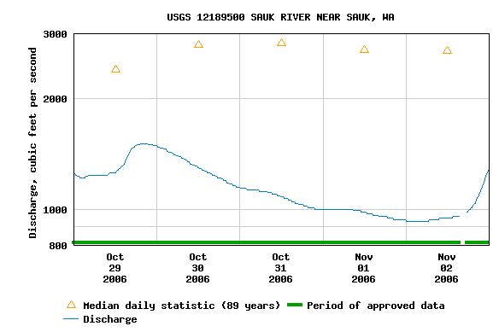
Oct 31-Nov 1, 2006

Slide 7
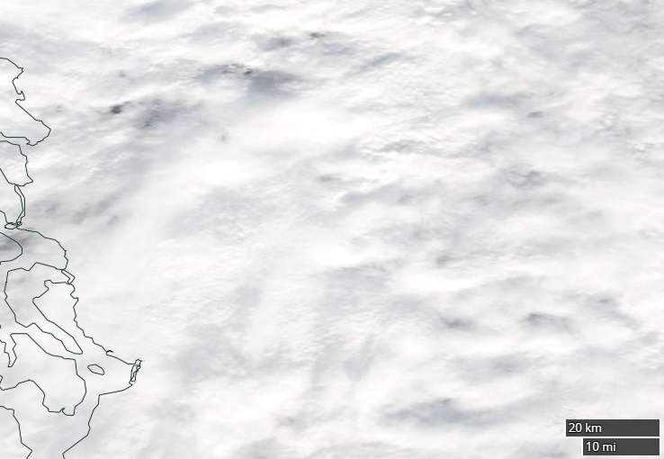
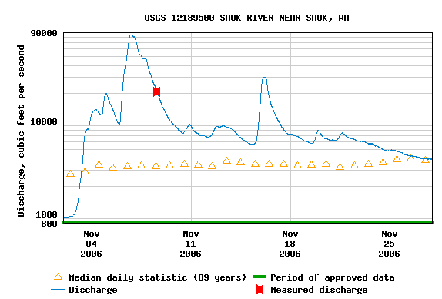
Nov 2-27, 2006

Slide 8
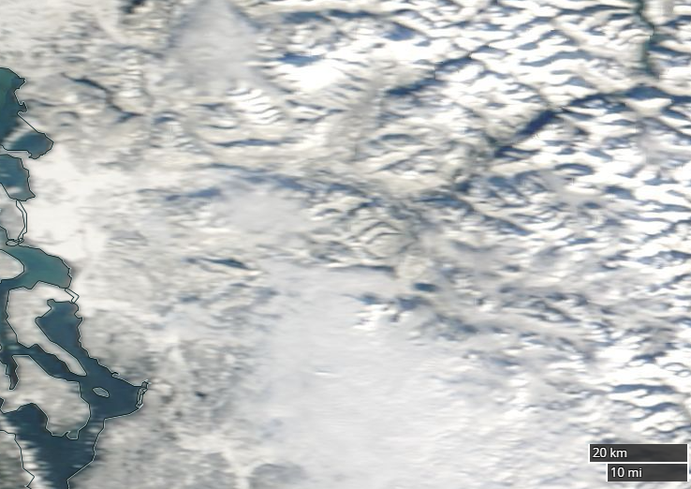
Nov 28, 2006

Slide 9
SNOW CONDITIONS in Oct-Nov 2006
MODIS viewer
https://worldview.earthdata.nasa.gov/?p=geographic&l=VIIRS_SNPP_CorrectedReflectance_TrueColor(hidden),MODIS_Aqua_CorrectedReflectance_TrueColor(hidden),MODIS_Terra_CorrectedReflectance_TrueColor,Reference_Labels(hidden),Reference_Features(hidden),Coastlines&t=2009-10-11&z=3&v=-123.2169476568072,47.51714756600273,-120.9186078130572,49.48809483162773&ab=off&as=2006-10-01&ae=2006-10-08&av=3&al=true

Slide 10
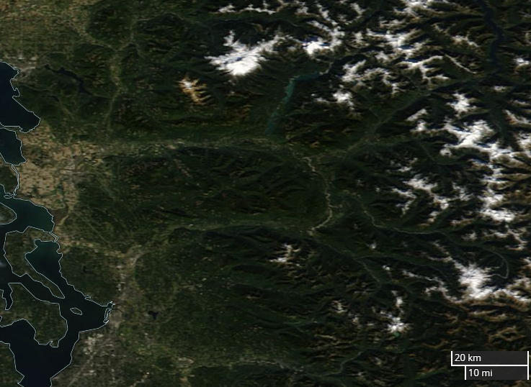
Oct 11, 2009

Slide 11
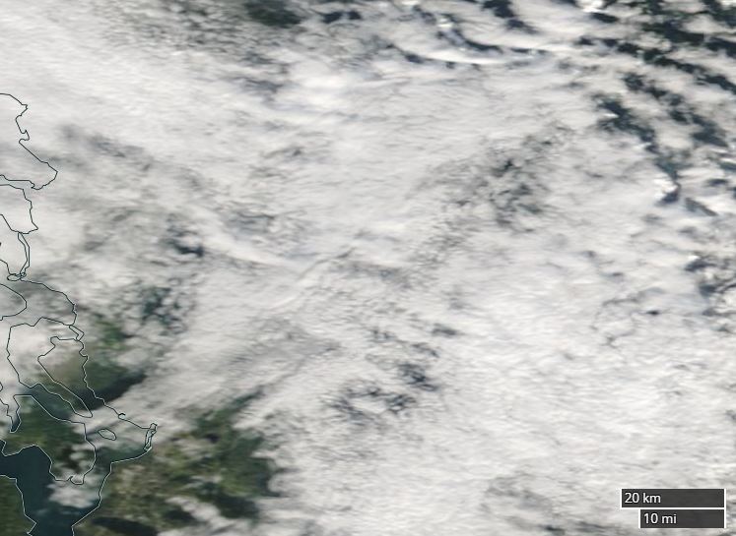
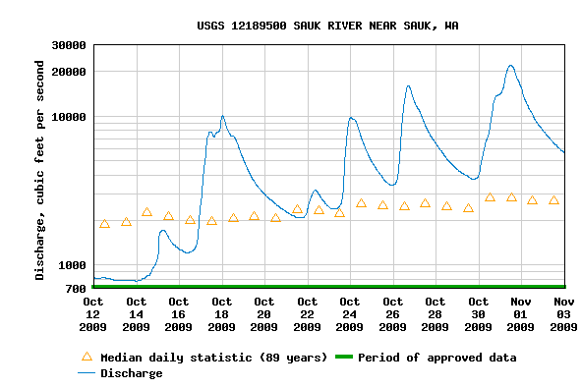
Oct 12-Nov 2, 2009

Slide 12
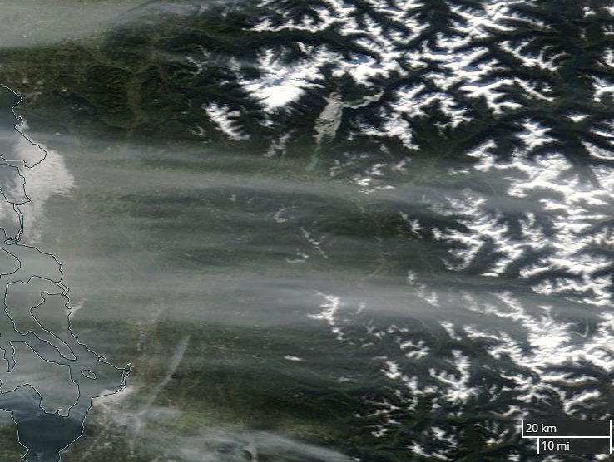
Nov 3, 2009

Slide 13
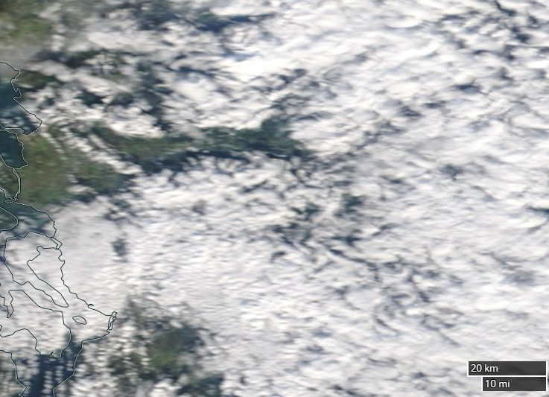
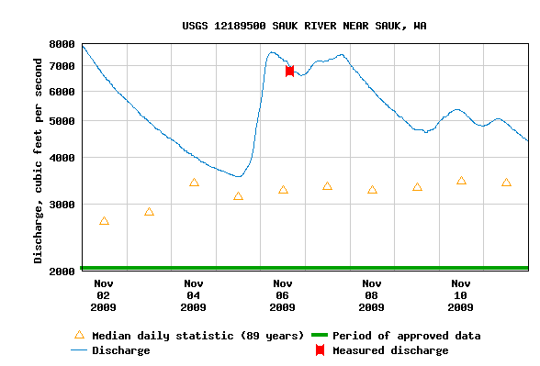
Nov 4-11, 2009

Slide 14
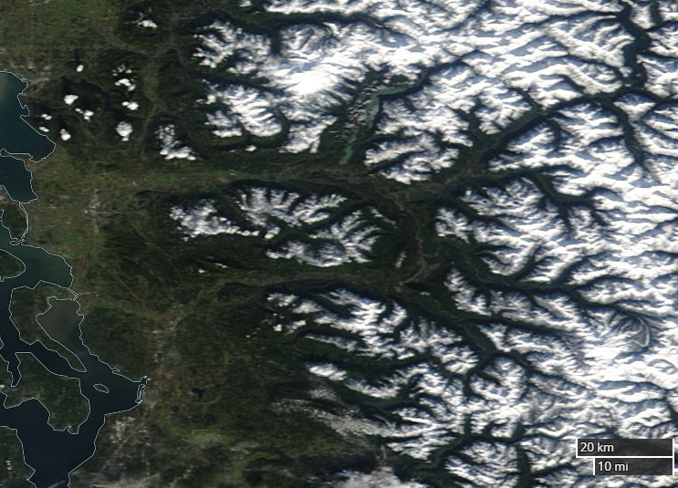
Nov 12, 2009

Slide 15
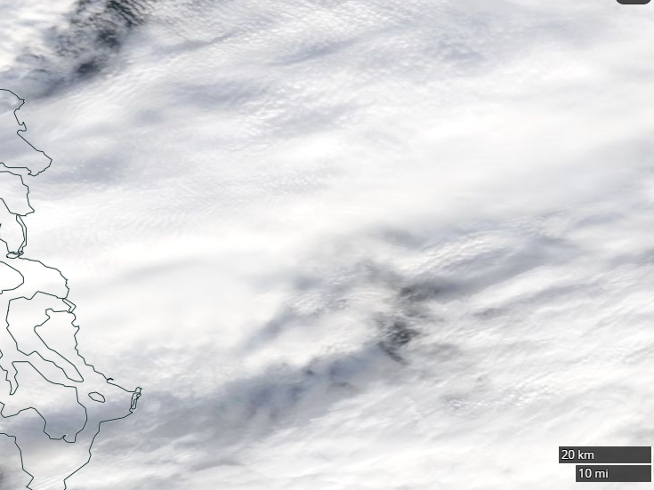
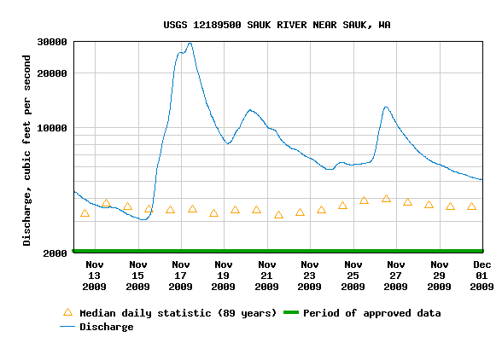
Nov 13-30, 2009

Slide 16
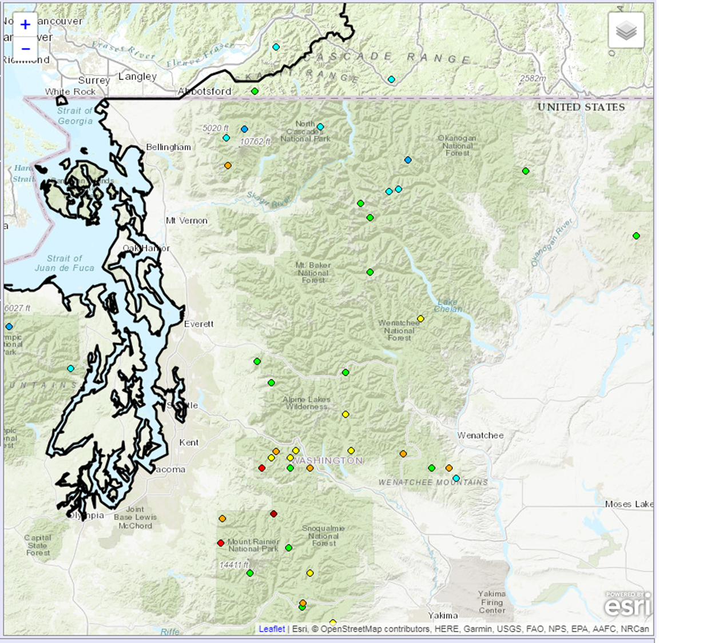
BEAVER PASS SNOTEL
THUNDER BASIN SNOTEL

Slide 17
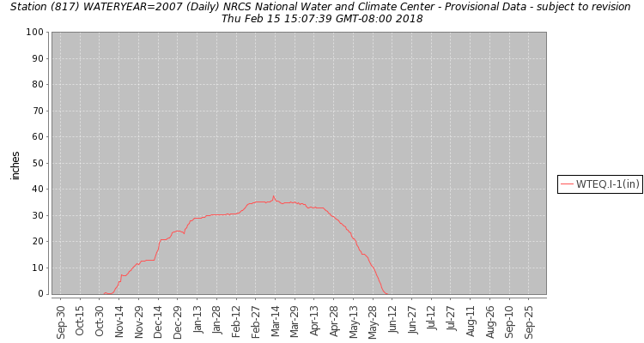
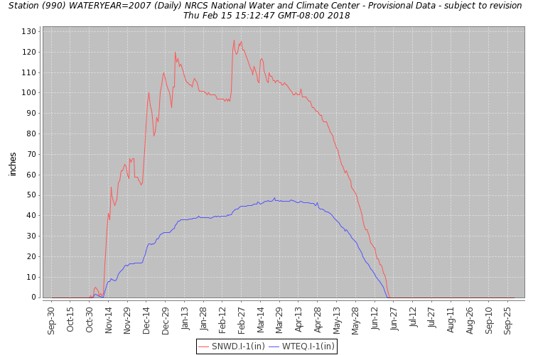
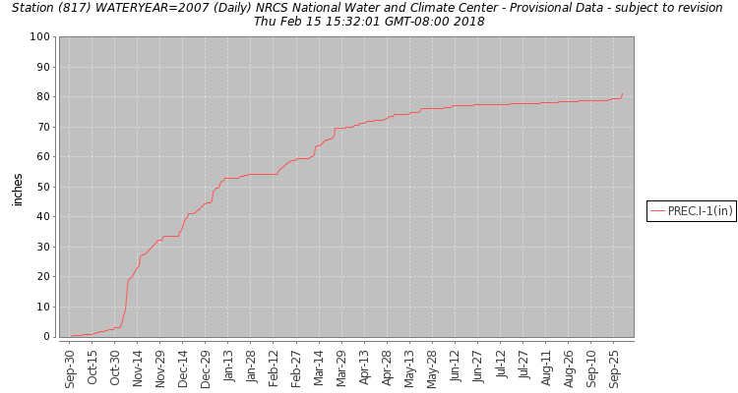
THUNDER BASIN SNOTEL
BEAVER PASS SNOTEL

Slide 18
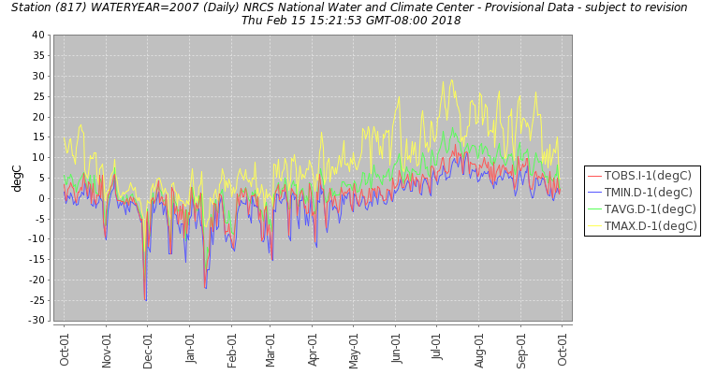
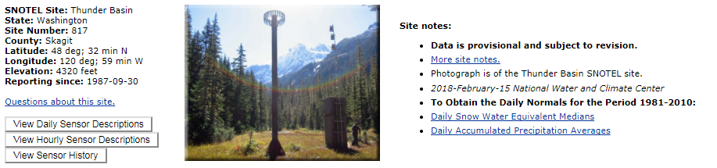
Nov 2006 – warm storm on very little snow

Slide 19
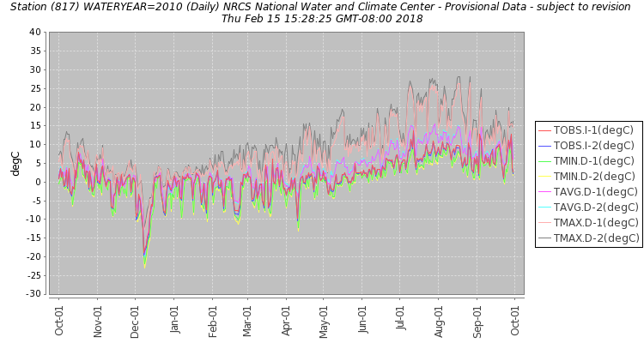
Nov 2009

